Slide 1

Vel Tech Rangarajan Dr. Sagunthala R&D Institute of Science and Technology
School of Computing
Department of Computer Science and Engineering
10211CS224 / FULL STACK APPLICATION DEVELOPMENT (JAVA)
PROJECT REVIEW : MILESTONE PROJECT – 1
Date: 25-03-2026
TrackWise: Relational Expense Analytics Platform
SDG: SDG 8 – Decent work and Economic Growth
Presented By:
M.Muni Sai Teja VTU24670
Reg.No:-23UECS0816
Courses Handling Faculty:
Dr.S.HEMAMALINI- M.E,Ph,D.,
Assistant Professor(Senior Grade)

Slide 2
INTRODUCTION
TrackWise is an intelligent expense analytics platform designed to help users efficiently track, manage, and analyze their financial spending.
The platform focuses on relational analysis of expenses, helping users understand how different spending categories are connected and how they affect overall budgeting
TrackWise enables users to record daily expenses, categorize transactions, and monitor financial habits in real time
The system uses data analytics and visualization techniques to provide insights through charts, summaries, and spending trends
It helps individuals identify unnecessary expenses and improve financial decision-making
The platform supports secure data storage and easy access, allowing users to manage their financial records anytime.
TrackWise is designed with a user-friendly interface to make expense tracking simple and efficient for everyone
The main goal of the project is to promote better financial planning and budgeting through smart expense analysis
1
2
3
4
5
6
7
8
9

Slide 3
PROBLEM STATEMENT
1
Many individuals find it difficult to track their daily expenses accurately, which leads to poor financial management.
Traditional methods such as manual recording in notebooks or spreadsheets are time-consuming and prone to errors.
Existing expense tracking systems often lack intelligent analysis, making it hard for users to understand spending patterns.
Users usually struggle to identify relationships between different expense categories, such as how lifestyle choices affect overall spending.
Without proper visualization tools, it becomes difficult to analyze financial trends and make informed budgeting decisions.
Many available solutions are either too complex or not user-friendly, discouraging consistent usage
There is limited support for real-time monitoring of expenses and financial insights in basic tracking systems.
Therefore, there is a need for a smart, automated, and user-friendly expense analytics platform like TrackWise that helps users track expenses, analyze spending relationships, and improve financial planning.
2
3
4
5
6
7
8
9

Slide 4
OBJECTIVE(S)
1
To design and develop a scalable expense analytics system using data processing and visualization techniques.
To implement real-time transaction categorization and analyze spending patterns for optimized budgeting.
2
3
4
5
6
7
8
9

Slide 5
PROPOSED SYSTEM
TrackWise is an intelligent platform for tracking and managing daily expenses.
It allows users to record and categorize transactions in real time.
The system uses data analytics to identify spending patterns and trends.
It solves the issue of manual expense tracking, which is time-consuming and error-prone.
Helps users understand relationships between different expense categories.
Provides visual insights through charts and summaries for better decision-making.
Offers secure data storage with easy access anytime, anywhere.
More efficient and user-friendly compared to traditional methods like notebooks or basic apps.
1
2
3
4
5
6
7
8
9

Slide 6
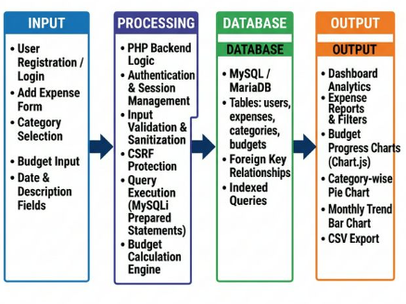
PROPOSED SYSTEM ARCHITECTURE
1
2
3
4
5
6
7
8
9

Slide 7
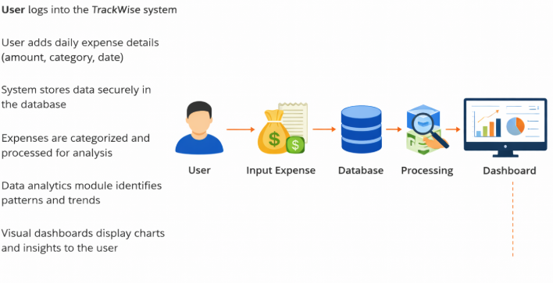
WORKFLOW
1
2
3
4
5
6
7
8
9

Slide 8
TECHNOLOGIES USED
Frontend: HTML5, CSS3, JavaScript (ES6) for structure, styling & interactivity.
Data Visualization: Chart.js library for pie charts and monthly bar charts.
Backend: PHP 7.4+ for server-side logic, form processing & session management.
Database Connectivity: MySQLi with prepared statements to prevent SQL injection.
Database: MySQL / MariaDB — 4 tables: users, categories, expenses, budgets.
Security: Bcrypt password hashing, CSRF tokens, input validation & XSS prevention.
Development Tools: XAMPP (Apache + MariaDB), phpMyAdmin, VS Code.
Hardware/Software Requirements: Windows OS, 2GB RAM, PHP 7.4+, modern browser with JavaScript enabled.
1
2
3
4
5
6
7
8
9

Slide 9
MODULE DESCRIPTION
Module 1: User Management Handles user registration, login, and logout with secure Bcrypt password hashing and session-based authentication.
Module 2: Expense Management Allows users to add, view, filter, search, and delete expenses with details like amount, category, date, and description.
Module 3: Category Management Enables users to create and manage custom expense categories. Default categories are auto-created on registration.
Module 4: Budget Management Lets users set monthly budget limits and tracks spending against them, displaying remaining balance in real time.
Module 5: Analytics & Dashboard Displays interactive charts (category-wise pie chart, monthly bar chart) and summary cards for total and monthly expenses.
Module 6: Data Export Provides CSV export of filtered expense records for offline analysis and reporting.
1
2
3
4
5
6
7
8
9

Slide 10
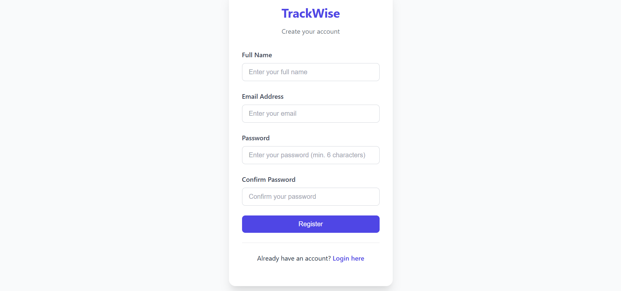
IMPLEMENTATION SCREENSHOTS
1. Home Page (Register)
1
2
3
4
5
6
7
8
9
The entry point where new users create an account by entering their name, email, and password.

Slide 11
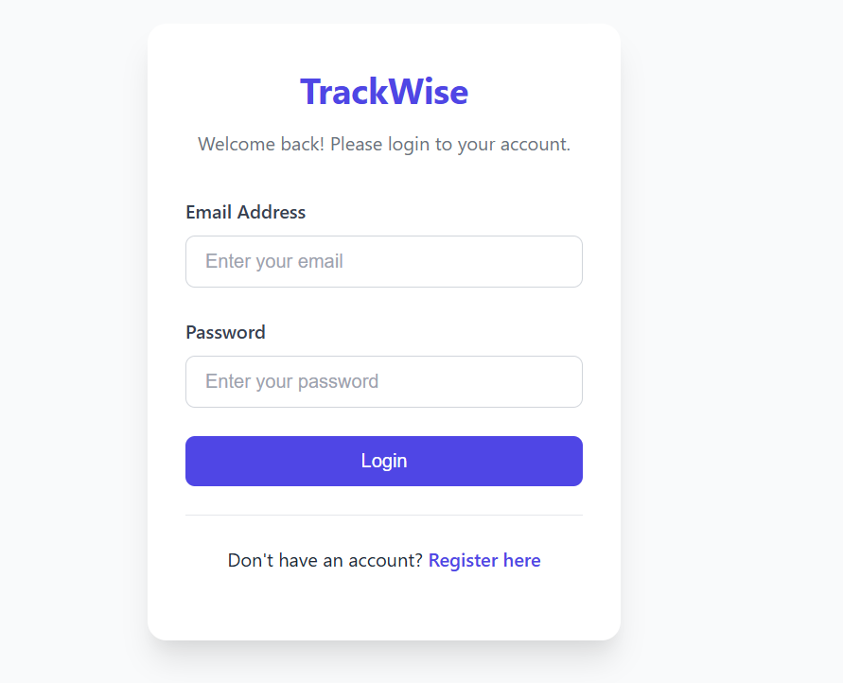
IMPLEMENTATION SCREENSHOTS
2. Login Page
1
2
3
4
5
6
7
8(A)
9

Slide 12
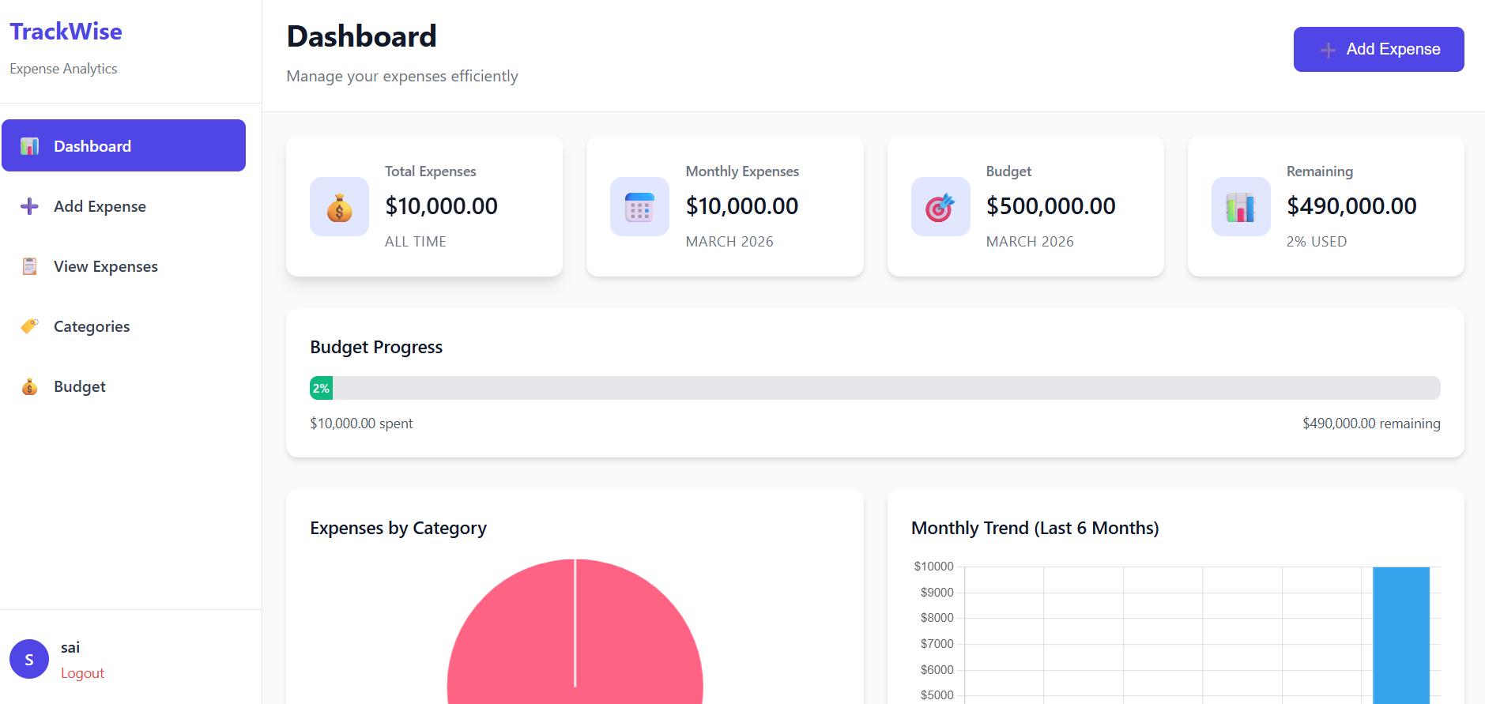
IMPLEMENTATION SCREENSHOTS
3. Main Module — Dashboard
1
2
3
4
5
6
7
8(B)
9
The central hub displaying total expenses, monthly spending, budget status, and analytics charts.

Slide 13
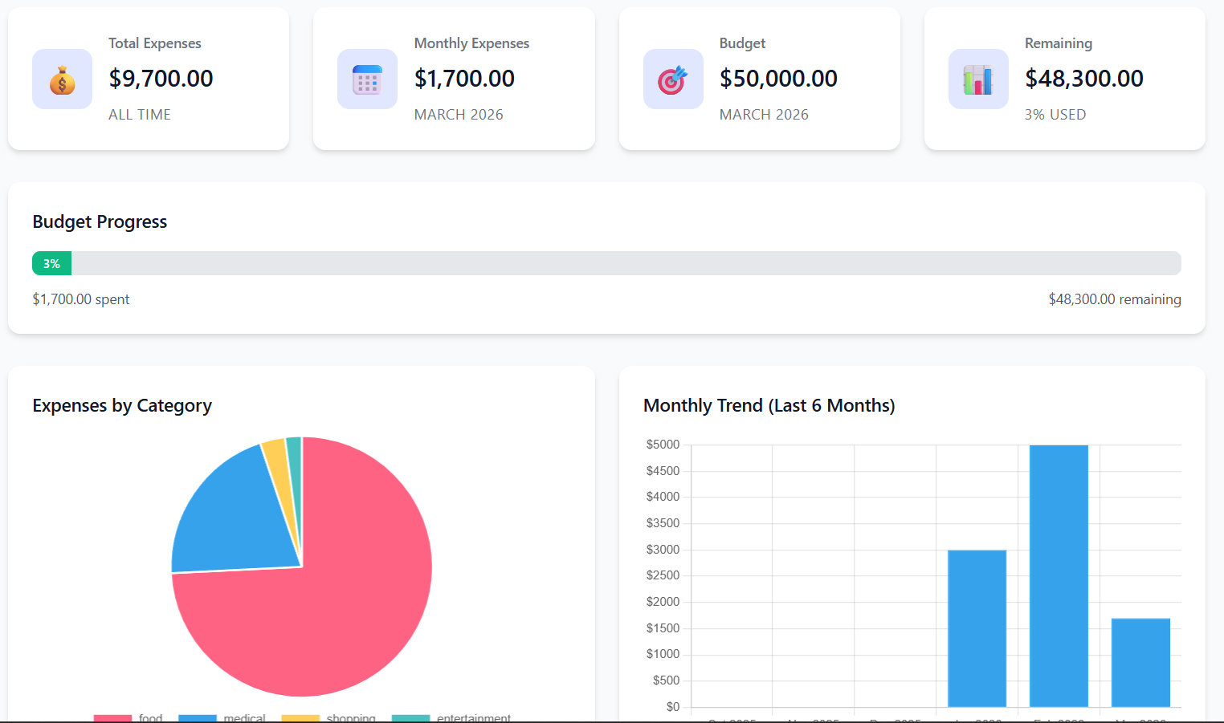
IMPLEMENTATION SCREENSHOTS
5. Output Page
1
2
3
4
5
6
7
8(C)
9
Displays all recorded expenses with search/filter options and a CSV export button for reporting.

Slide 14
ADVANTAGES & LIMITATIONS
1
Advantages:
Easy to Use — Simple, clean interface that requires no technical knowledge to track expenses
Real-time Analytics — Interactive charts (pie & bar) give instant visual insights into spending patterns
Secure — Bcrypt password hashing, prepared statements, CSRF tokens and session protection keep data safe
Category & Budget Control — Custom categories and monthly budget limits help users stay financially disciplined
Limitations:
Single User Per Account — No multi-user collaboration or shared expense tracking between users
Local Deployment Only — Requires XAMPP setup; not directly accessible online without additional configuration
No Mobile App — Only a web-based interface; no dedicated Android/iOS app
No Recurring Expense Automation — Users must manually re-enter repeating expenses each time
2
3
4
5
6
7
8
9

Slide 15
Thank you

